Slide 1
ORPHANAGE MANAGEMENT SYSTEM

Slide 2
TEAM MEMBERS
C VAISHNAVI(2110030096)
P PRANEETHA(2110030099)
S SAI NIKHITHA (2110030098)
G VAMSHI(2110030370)

Slide 3
INTRODUCTION
As orphanages has been little in old style practice it lead to managing orphanage system in manual way which is storing information in notebook or registers.
People need to store not one two columns of information they need different sets for storing different sectors of information.
As there are many systems to manage the orphanage like students entry , adoption , supplies information, and many more .
All this managing is not been easy as they may lead to lot of confusion.

Slide 4
OBJECTIVE
The main objective is to create an application for managing the number of orphans, their names, personal habits, activities, their original parents, health conditions, etc. details.
The app should be able to successfully manage the entire process with adequate information. We would make the app with all the necessity elements to run the orphanage smoothly .
With this maintaining the records of the orphanage will be made easy to handle and access by the officials.
It will enhance timeliness, accuracy, reliability and above all easy access to data and information.
The system will help to reduce the high rate of labour using to its high level of automation and independency

Slide 5
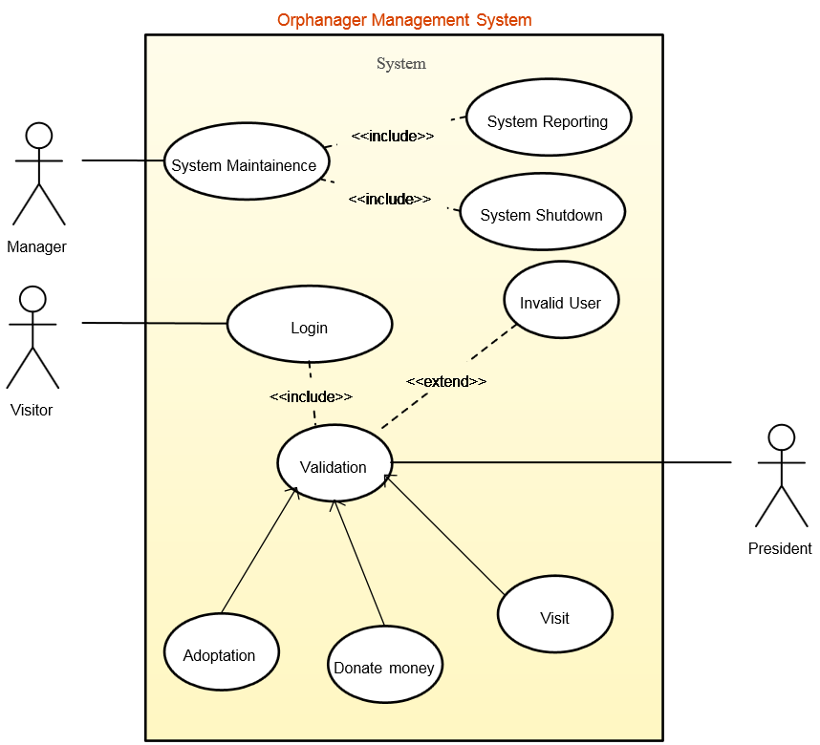
USE CASE DIAGRAM

Slide 6
Data Set Collection
Dataset is a collection of related sets of information that
is required in Application building.
Name
Age
DOB
Donor

Slide 7
TOOLS REQUIRED
Frontend
Django through PyCharm
Backend
Star UML
MySQL

Slide 8
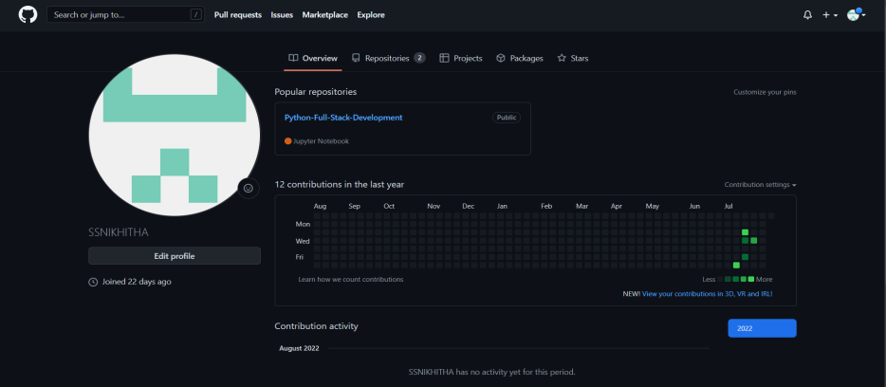
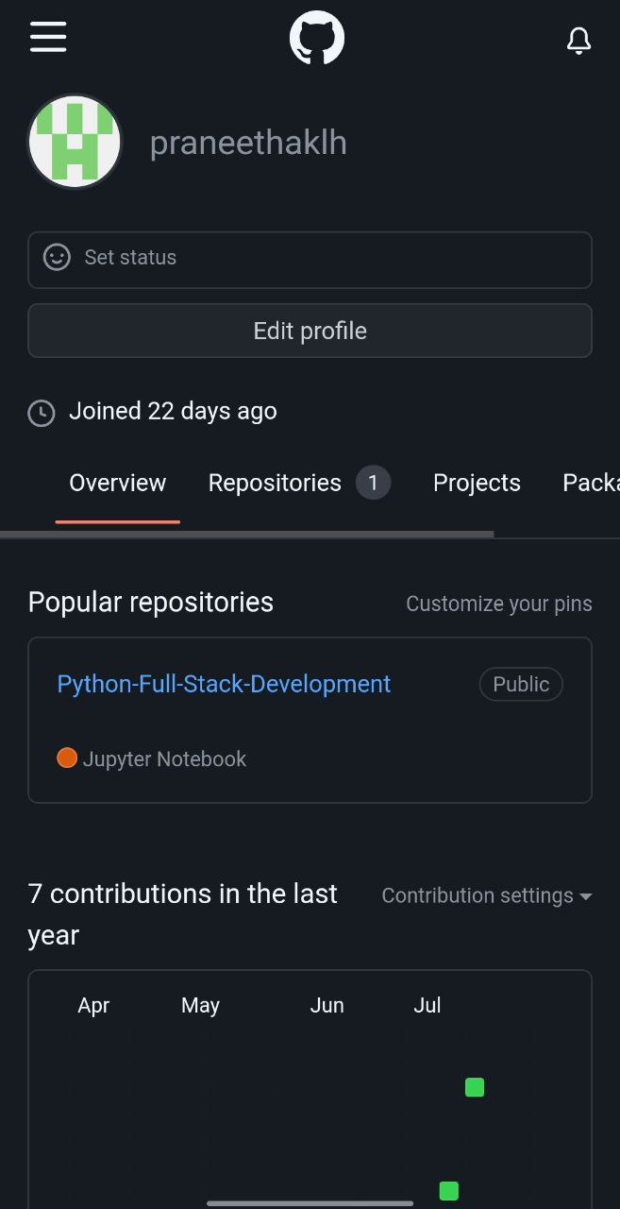
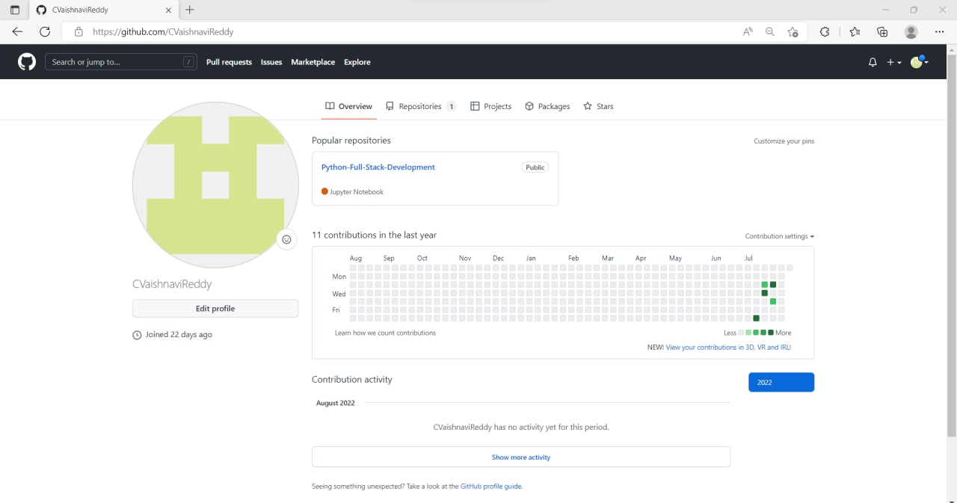
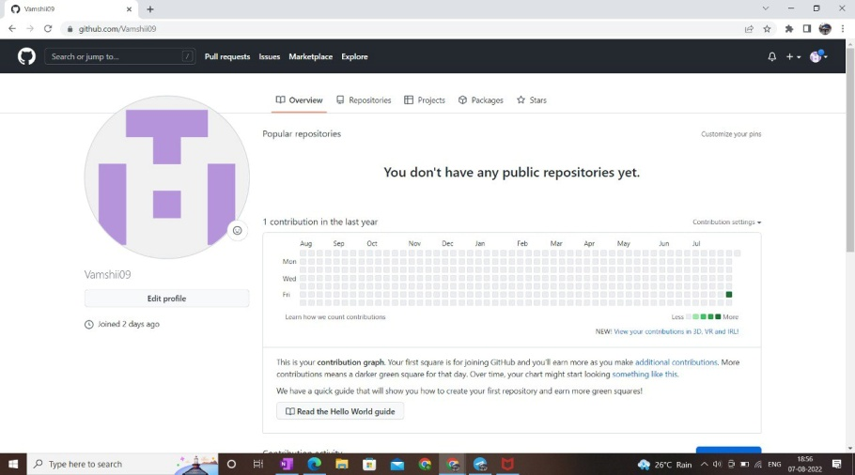
GitHub setup

Slide 9
Division of work among the group members
S SAI NIKHITHA - Frontend work
P PRANEETHA - Frontend work
C VAISHNAVI- Backend work
G VAMSHI- Backend work

Slide 10


